Slide 1

IST DEV
ΔΗΜΗΤΡΗΣ ΜΑΣΣΑΑΝΤ
ΓΙΩΡΓΟΣ ΤΣΕΓΚΑΣ
ΑΛΕΞΑΝΔΡΟΣ ΛΕΟΝΤΑΚΙΑΝΑΚΟΣ

Slide 2
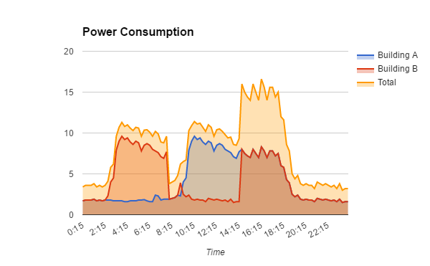
NEED- MARKET GAP

Slide 3
OUR APPROACH
Ranges - measurement
Input - Compare
Make proposal
Take action
Repeat

Slide 4
BENEFITS
Added value and benefit for all the members involved
Great opportunities and continuous evolution

Slide 5
CONCLUSION
“Same consumption,
smarter actions,
in a more economic way”

Slide 6
BUSINESS MODEL CANVAS
1. Key Partners
ΔΕΗ - O.T.A - Bank
Reduced resources for the electricity provider. Reduced electricity billing. High investment payoff.
3. Value Proposition
Efficient usage of energy power - reduced expenses
Meet the needs of: money saving, better distribution of power consumption, resources saving. Contributes to the transparency of local authorities by offering the organization's power consumption data.
5. Customer Segments
O.T.A and Mid-voltage consumers
The Electrolution service will be initially implemented on O.T.A buildings and after a whole year of usage it will be available for Mid-voltage consumers.
2. Key Activities
Energy consumption measurement & stabilization
Collaboration between actors (buildings).
6. Key Resources
Hardware & Software
Raspberry pi with two addons (controller, sensors) Server running nodejs with HTML, CSS and JavaScript for front-end
4.Customer Relationships
Direct & win-win relationship
Direct communication among our business and the customers in order to regulate the energy consumption. After sales services (guarantee and repair)
7. Channels
Bank institutions
The Electrolution service will be provided through Bank institutions which will simultaneously offer initial funding. Consumers who can afford the service will be able to purchase it, directly from our business.

Slide 7
Flow Chart
Δ
Controller
-------------
Sensor
Controller
-------------
Sensor
A
B
Open Data

